Slide 1
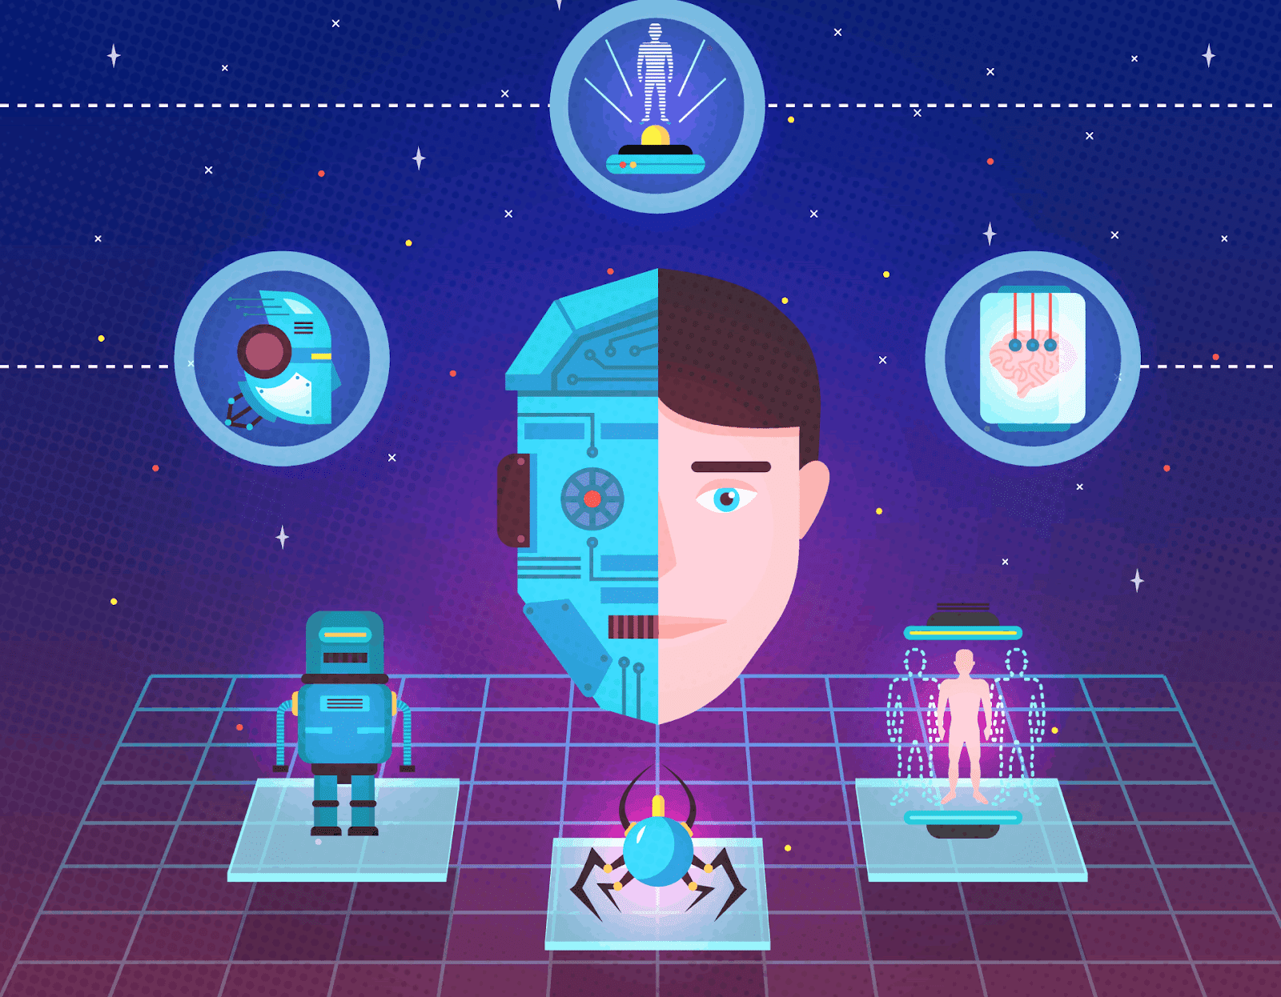
Deepfake Detection
Submitted To :
Prof. Anupam Agrawal

Slide 2
TEAM MEMBER :
Hritik Kumar (IIT2021014)
Pratik Sharma (IIT2021026)
Deepak Raj (IIT2021039)
Mohit Kumar (IIT2021059)
Shresth Sharma (IIT2021089)

Slide 3
Content
Introduction
Literature Review
Problem Statement
Proposed Methodology
Tools and Technology
Dataset (Test Data)
References

Slide 4
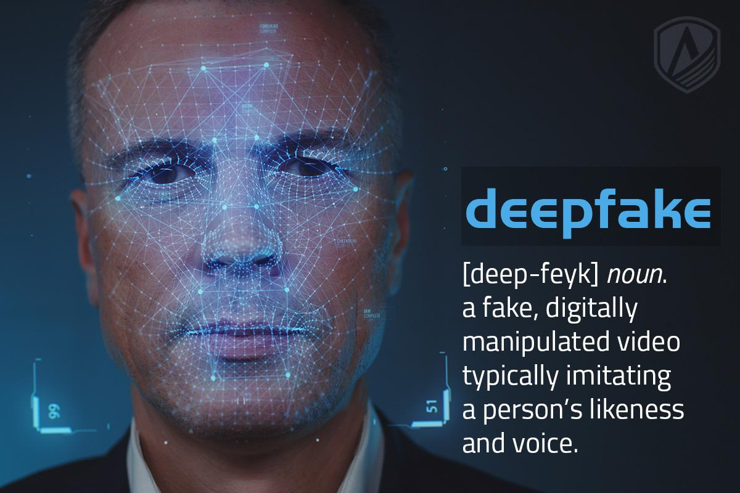
What is deepfake ?
Definition: Synthetic media (video or audio) created using AI, especially deep learning, to mimic real people convincingly.
Technology: Utilizes Generative Adversarial Networks (GANs) to learn and replicate realistic images, facial movements, or voices.
Applications:
Entertainment: Face-swapping, movie effects, and apps.
Education & Training: Recreates historical figures or scenarios for simulations.
Malicious Use: Used for disinformation, fraud, or political manipulation.
Challenges:
Detection is becoming harder as the technology improves.
Raises privacy, security, and misinformation concerns.
Examples: Fake political speeches or altered videos made to deceive viewers

Slide 5
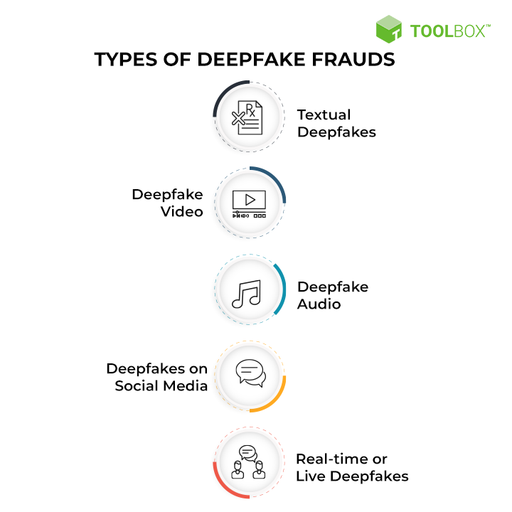
Types of Deepfake
Deepfake Lip-sync: AI can manipulate videos to match a person’s lip movements with any audio, even if the person never spoke those words. This technology is used to make realistic fake videos where the subject appears to say something they didn’t, adding a layer of deception.
Deepfake Video: AI creates fake photos and videos, widely used in social media for deceptive content. Programs like MarioNETte can simulate facial gestures of historical or famous figures.
Deepfake Audio: AI can clone voices using audio samples. Tools like Lyrebird and Deep Voice mimic voices after minimal input, making it hard to distinguish real from fake.
Deepfakes on Social Media: Fake profiles like "Maisy Kinsley" are used for financial manipulation, often undetectable by regular users.
Real-time Deepfakes: Tools like DeepFaceLive allow real-time face-swapping during live streams, used on platforms like Twitch for entertainment or deception.

Slide 6
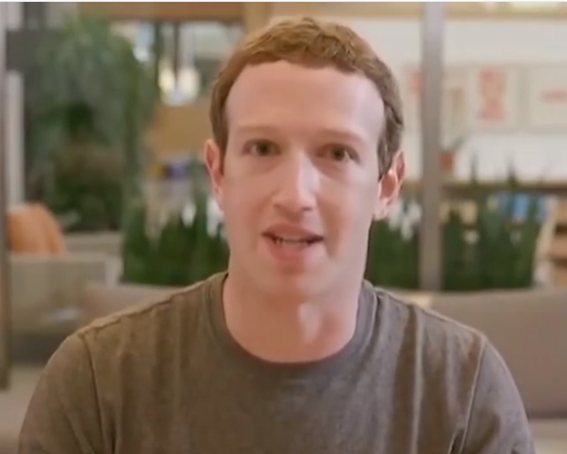
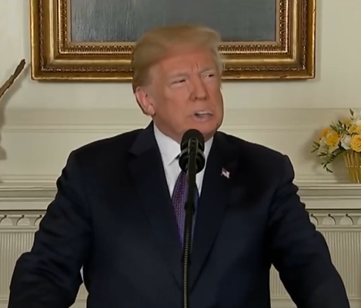
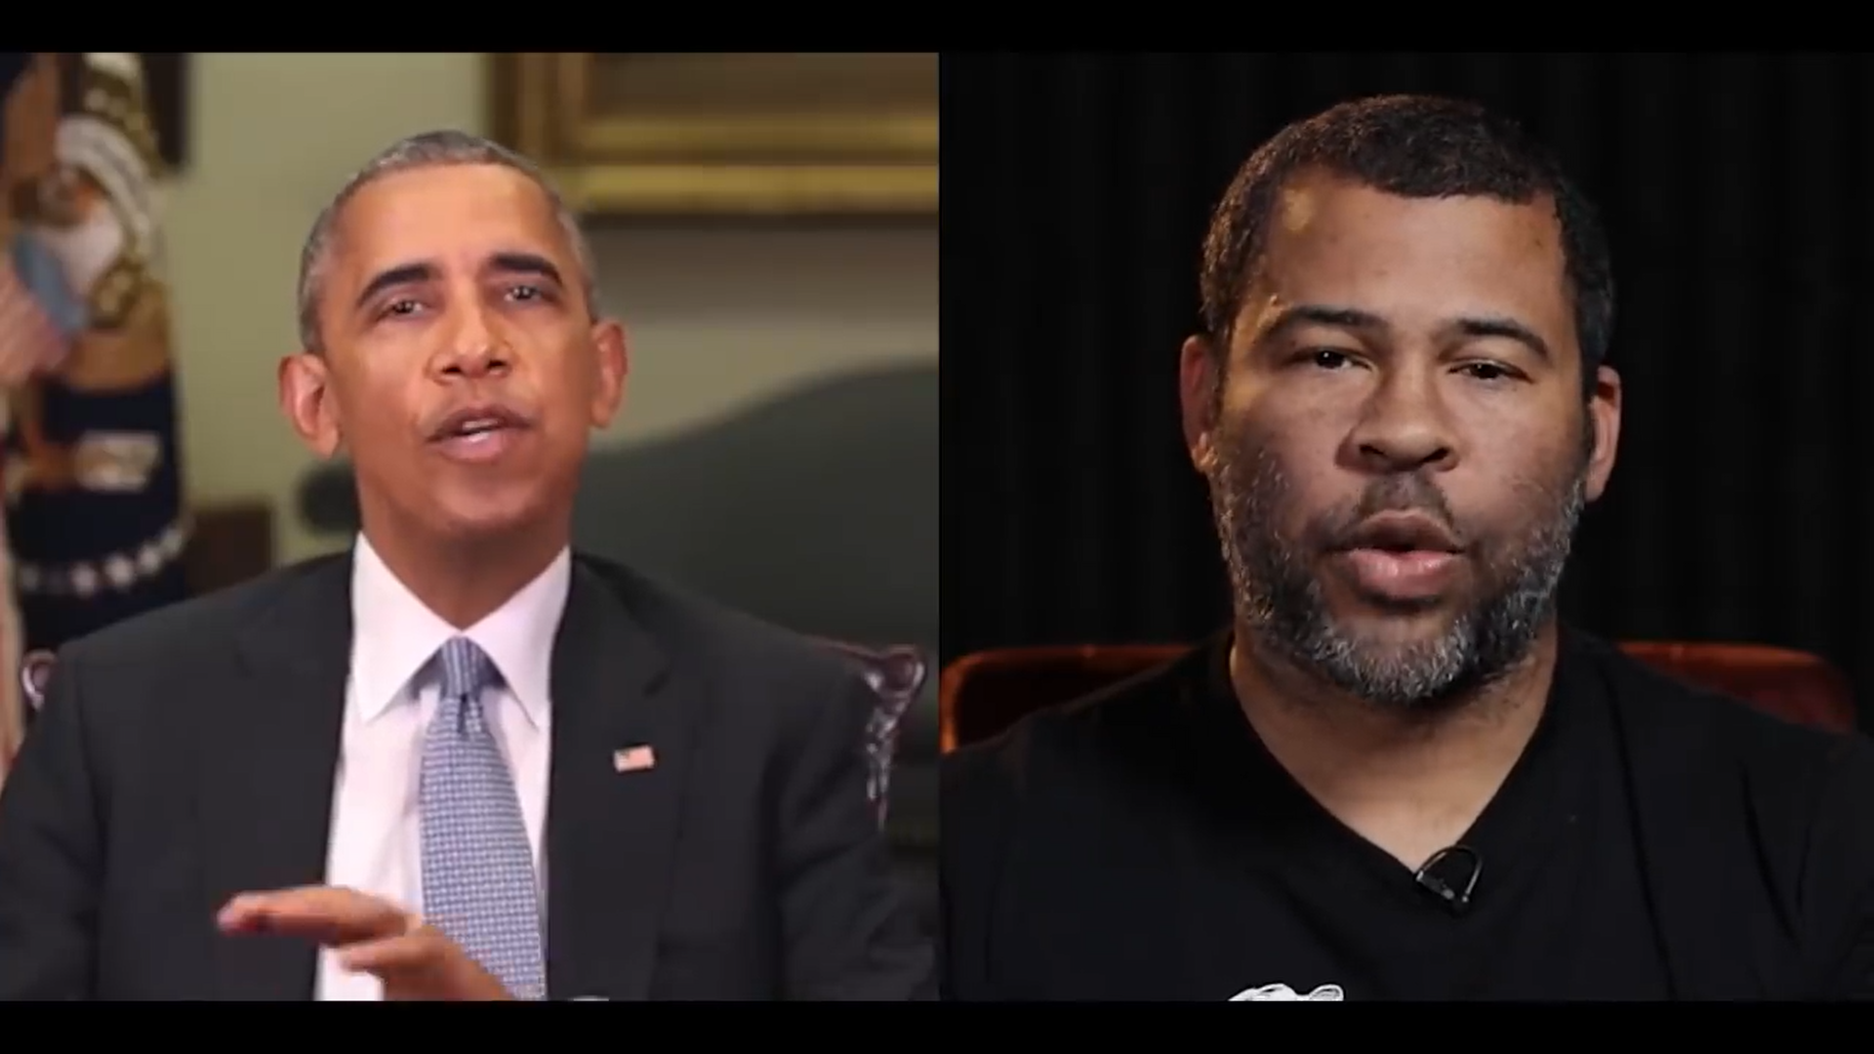
Why Deep Fake Detection ?
Fake News
Malicious hoaxes
Financial fraud
Celebrity unusual video
Revenge porn
Politician videos

Slide 7
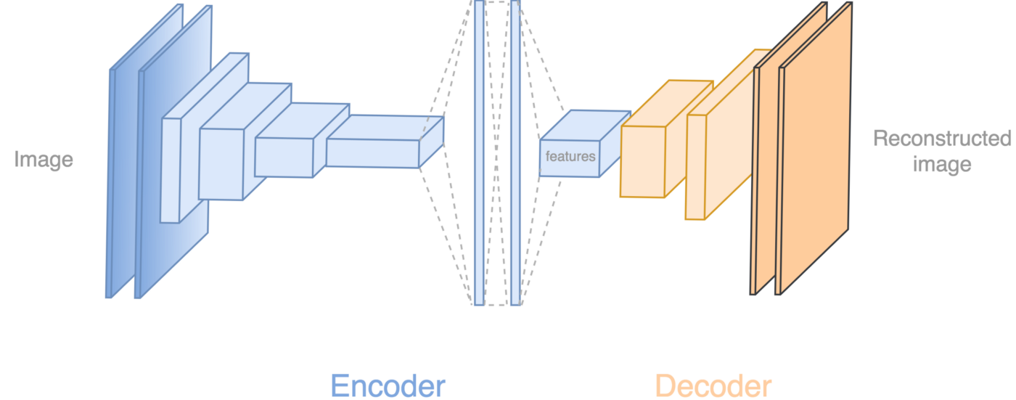
How Deep Fakes Are Created ?
Tools for deep fake creation.
Faceswap
Faceit
DeepFaceLab
DeepfakeCapsuleGAN
Large resolution facemasked

Slide 8
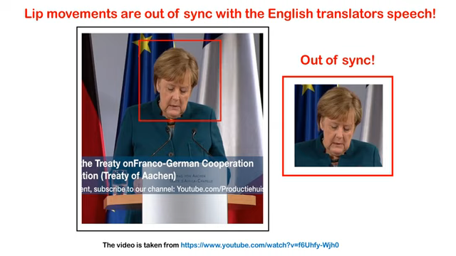
Wav2Lip: Accurately Lip-syncing Videos In The Wild

Slide 9
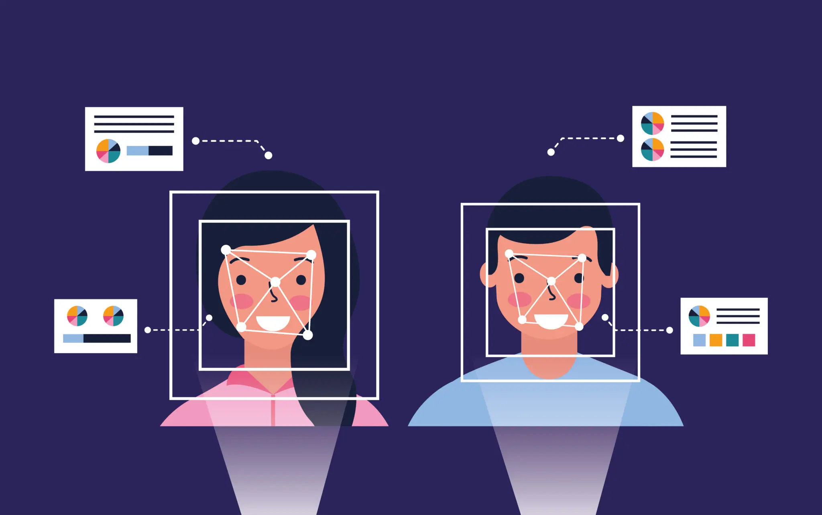

Problem Statement
Lip-Sync Deepfake Detection from Audio-Video Mismatch

Slide 10
Introduction
1. Proliferation of Deepfake Technology: Deepfakes, especially lip-sync variants, are increasingly used for disinformation and fraud, as noted in Bohacek and Farid's 2024 CVPR Workshop paper.
2. Lip-Sync Deepfake Detection: The method compares transcriptions from both audio and lip-reading to detect discrepancies, achieving high accuracy despite certain challenges [1].
3. Challenges in Lip-Sync Detection: Detecting lip-sync deepfakes is hindered by the accuracy of lip-reading models and difficulties with non-English languages.
4. Deepfake Audio Detection in Group Conversations: Deep learning techniques integrating speech-denoising and CNNs are used to detect fake audio in group settings with high accuracy [2].
5. Challenges in Deepfake Audio Detection: Dataset dependency and overfitting remain key challenges in deepfake audio detection systems.

Slide 11
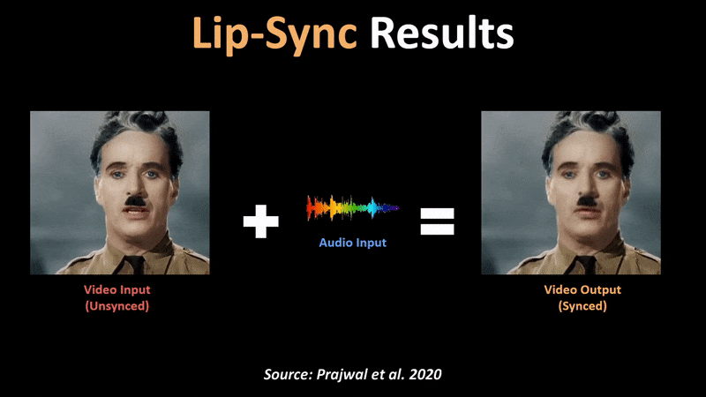
6. Systematic Literature Review:
A review of deep learning-based deepfake detection methods shows that CNNs are most commonly used, with ongoing challenges in model generalization and dataset diversity [3].
7. Hybrid CNN-RNN Detection Method:
Combining CNNs with RNNs improves deepfake detection by analyzing video frame inconsistencies over time, though it is computationally expensive and dataset-dependent [4].
8. Current Gaps in Detection:
The review highlights gaps in model generalization and dataset diversity, indicating a need for more robust and varied detection solutions.
9. Challenges of Hybrid Models:
The CNN-RNN method, while accurate, is computationally heavy and relies on high-quality datasets, limiting its use in real-time detection scenarios.
10. Project Aim:
This project seeks to develop a hybrid system for detecting deepfakes in both video and audio, addressing limitations in previous studies by optimizing performance and expanding dataset diversity.

Slide 12
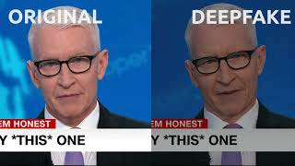
Can we detect Deep fakes?
https://youtu.be/3wVpVH0Wa6E?si=ETAJdJ5-xbUrVnHZ

Slide 13
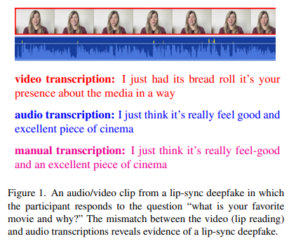
PAPER 1: LOST IN TRANSLATION: LIP-SYNC DEEPFAKE DETECTION FROM AUDIO-VIDEO MISMATCH (CVPR, 2023) [1]
Objective: Detect lip-sync deepfakes by identifying mismatches between audio and video.
Approach:
1. Audio-to-Text Transcription: Using Whisper’s pipeline to extract audio transcript.
2. Video-to-Text Transcription (Lip-reading): Using Auto-AVSR to transcribe video from lip movements.
Detection: Quantify mismatch using normalized Levenshtein distance between audio and video transcriptions.
Thresholding: A threshold is applied to separate real videos from deepfakes.
[1]

Slide 14
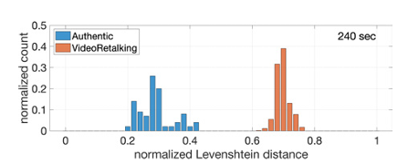
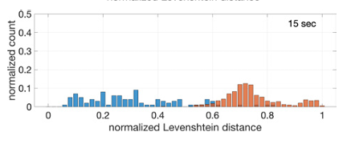
LOST IN TRANSLATION: DATASET OVERVIEW
Controlled Dataset:
10 individuals recording responses and reading a script.
5-minute videos per individual.
90 lip-sync deepfakes generated using VideoRetalking and Wav2Lip.
Anderson Cooper Dataset:
36 minutes of CNN footage, 64 videos (30s each).
640 lip-sync deepfakes generated.
In-the-Wild Dataset:
14 verified deepfake videos (e.g., Joe Biden, Taylor Swift).
Video lengths between 5 to 122 seconds.
The distance between audio and video transcriptions for authentic and VideoRetalking lip-sync videos of varying length. Alarger distance corresponds to a larger mismatch. For videos 60 seconds or longer a distance threshold of 0.5 perfectly separates the authentic from the fake.
[1]

Slide 15
LOST IN TRANSLATION: RESULTS
Controlled Dataset:
Median Levenshtein Distance:
Real videos: 0.26
VideoRetalking & Wav2Lip deepfakes: 0.69 (clear separation).
Anderson Cooper Dataset:
Real videos: Median distance 0.16.
Deepfakes: Median distance for VideoRetalking (0.66) and Wav2Lip (0.63).
Threshold: 97.5% (VideoRetalking) and 98.3% (Wav2Lip) of deepfakes correctly classified as fake.

Slide 16
LIPINC: Detecting Lip-syncing Deepfakes from Mouth Inconsistencies[2]
Deepfakes Overview:Definition of deepfakes and their societal risks (identity theft, misinformation, fraud).Focus on lip-syncing deepfakes, where only the mouth region is manipulated to sync with altered audio.LIPINC Approach:Objective: Detect lip-syncing deepfakes by analyzing spatial-temporal inconsistencies in the mouth region.Unlike other methods, LIPINC focuses solely on visual cues, ignoring audio.Challenge: Subtle mouth inconsistencies are difficult to detect by human observation, especially in high-quality deepfakes.

Slide 17
Methodology & Implementation
Local and Global Mouth Frame Extraction:
Uses a face detector (e.g., Dlib) to extract the mouth region and select frames where the mouth is open.
Local Consistency: Extracts adjacent frames for mouth shape comparison.
Global Consistency: Extracts non-adjacent frames with similar mouth poses for cross-frame comparison.
Mouth Spatial-Temporal Inconsistency Extractor (MSTIE):
Uses a 3D Convolutional Neural Network (3D-CNN) to extract spatial-temporal features from the mouth region.
Two branches: Color branch (focuses on mouth color changes) and Structure branch (captures shape/teeth inconsistencies).
Inconsistency Loss Function:
Measures the Structural Similarity Index (SSIM) between video frames to detect inconsistencies.
Output: Probability of whether the video is fake or real based on these inconsistency features.

Slide 18
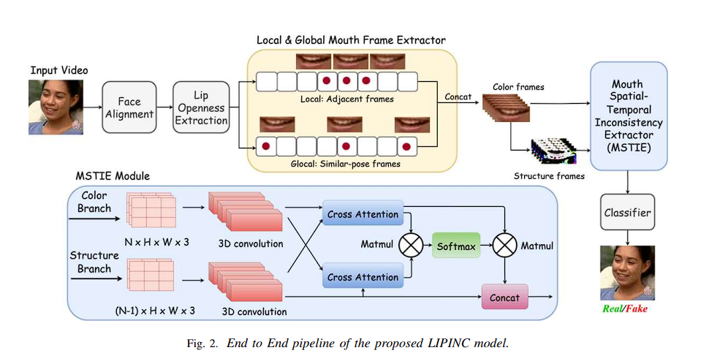

Slide 19
Accuracy & Results
In-domain Testing Results (FakeAVCeleb):
Accuracy: 99% on detecting lip-sync deepfakes.
AUC: 0.99 for lip-sync deepfakes (higher than other methods).
Precision: 99% precision, outperforming other state-of-the-art methods.
Cross-domain Testing Results (KODF & LSR+W2L):
KODF Dataset:
AUC: 87% for lip-sync detection.
LSR+W2L Dataset:
AUC: 90% for cross-type detection.
Shows strong generalization across unseen lip-sync deepfakes.

Slide 20
DEEPFAKE AUDIO DETECTION: RESULTS
Speech Denoising Results:
MLP Architecture: Training accuracy = 93%, Test accuracy = 88%.
CNN Architecture: Training accuracy = 94%, Test accuracy = 89%.
Speaker Diarization Results:
Achieved 80% accuracy, with DER = 0.52 (lower is better).
Deepfake Detection Results:
Accuracy: 94%
Loss Value: 0.691.
Comparison of Features:
Short-Term Fourier Transform (STFT): 47.55% accuracy.
Mel-Spectrogram: 41.14% accuracy.
Mel Frequency Cepstral Coefficients (MFCC): 88.80% accuracy.

Slide 21
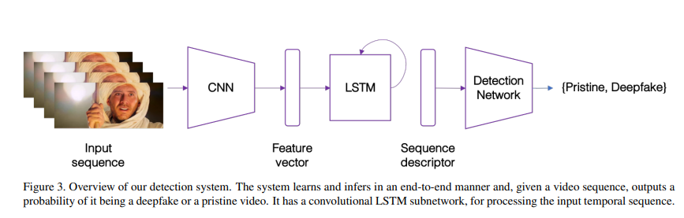
PAPER 3: DEEPFAKE VIDEO DETECTION USING CNN AND RNN (AICCIT, 2023)[4]
Overview: The paper presents a novel method to detect deepfake videos using a combination of Convolutional Neural Networks (CNN) and Recurrent Neural Networks (RNN), specifically Long Short-Term Memory (LSTM) units.
Pipeline:
CNN Feature Extraction: Frame-level features are extracted using a CNN architecture, specifically InceptionV3, which is pre-trained on ImageNet.
RNN for Temporal Analysis: The extracted features are fed into an LSTM network that captures temporal inconsistencies between frames, introduced by the face-swapping process in deepfake videos.
Key Advantage: The approach combines spatial and temporal analysis to detect anomalies in deepfake videos, which allows it to exploit temporal artifacts that are hard to detect at the frame level alone.
[4]

Slide 22
DEEPFAKE VIDEO DETECTION: DATASET OVERVIEW
Dataset Composition: The dataset consists of 600 videos.
300 Deepfake videos collected from various video-hosting websites.
300 Pristine videos from the Human Actions HOHA dataset, which includes movie clips emphasizing human actions.
Dataset Division:
The dataset was split into training (70%), validation (15%), and test (15%) sets, with a balanced number of deepfake and pristine videos in each split.

Slide 23
DEEPFAKE VIDEO DETECTION: RESULTS
Metric | Base Model | CNN+RNN Model
Accuracy | 80% | 89%
Precision | 50% | 60%
Recall | 70% | 90%
F-measure | 60% | 89%
Evaluation Metric: Accuracy of detecting deepfake videos.
Experimental Setup:
The system was evaluated using different lengths of video sub-sequences: 20, 40, and 80 frames.
Optimizer: Adam with a learning rate of 1e−5.
Results:
20 Frames: 96.7% Test Accuracy
40 Frames: 97.1% Test Accuracy
80 Frames: 97.1% Test Accuracy
Observation: The model can achieve accurate detection (97%+) with as few as 40 frames (~2 seconds of video).

Slide 24
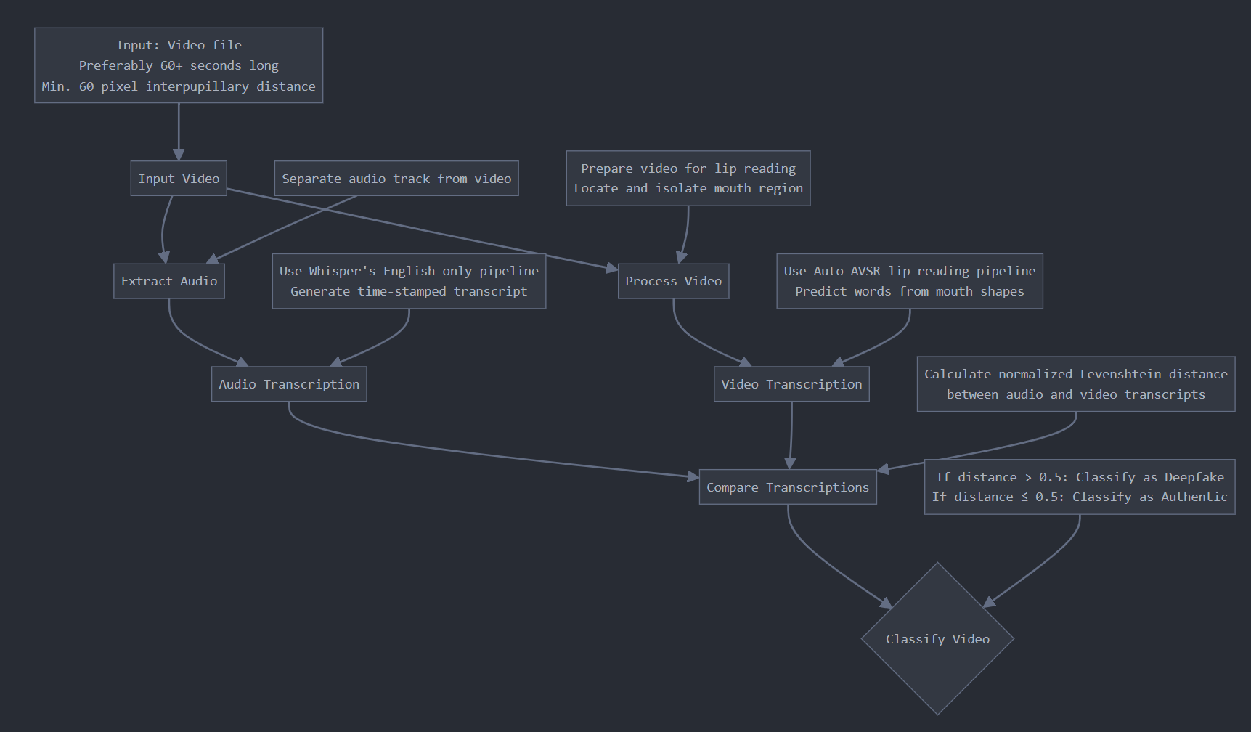
Proposed Methodology
Flow Diagram of Proposed Methodology

Slide 25
Proposed Methodology
Input: Take a video as input (preferably 60 seconds or longer for optimal results).
Audio Transcription:
Extract the audio from the video.
Use Whisper's English-only pipeline to transcribe the audio to text.
This yields a time-stamped transcript of the spoken words.
Video Transcription (Lip Reading):
Use Auto-AVSR's lip-reading pipeline to transcribe the video.
This involves: a. Finding the largest mouth region in each frame. b. Defining a bounding box around the mouth. c. Isolating the mouth in each video frame. d. Analyzing the grayscale mouth frames using an encoder-decoder model. e. Predicting timestamps of discrete words based on mouth shapes and context.
Transcription Comparison:
Compare the audio and video transcriptions using the normalized Levenshtein distance.
This quantifies the difference between the two transcriptions on a scale of 0 to 1.
Classification:
Apply a threshold (e.g., 0.5) to the normalized Levenshtein distance.
If the distance is below the threshold, classify the video as authentic.
If the distance is above the threshold, classify the video as a lip-sync deepfake.

Slide 26
Dataset Information
1. FakeAVCeleb Dataset :
- Focus: Audio-video deepfakes (lip-syncing, face-swapping, voice cloning).
- Composition: 500 real, 20,000 fake videos.
- Purpose: Benchmark for deepfake detection.
- Significance: Diverse, large-scale dataset ideal for lip-sync detection models.
2. KODF Dataset
- Focus: Korean deepfake detection (lip-syncing, face-swapping).
- Composition: 62,166 real, 175,776 fake videos.
- Purpose: Evaluates model generalization across languages.
- Significance: Cross-domain performance testing with Korean subjects.
3. LSR+W2L Dataset
- Focus: Lip-sync detection.
- Composition: 1,000 real, 1,000 fake videos.
- Purpose: Training/evaluating lip-sync detection models.
- Significance: Tailored for lip-sync-specific detection tasks.
4. Dataset Significance
- FakeAVCeleb: Benchmark for detecting lip-syncing and face-swapping.
- KODF: Tests generalization across domains (Korean).
- LSR+W2L: Focused evaluation on lip-sync detection.

Slide 27
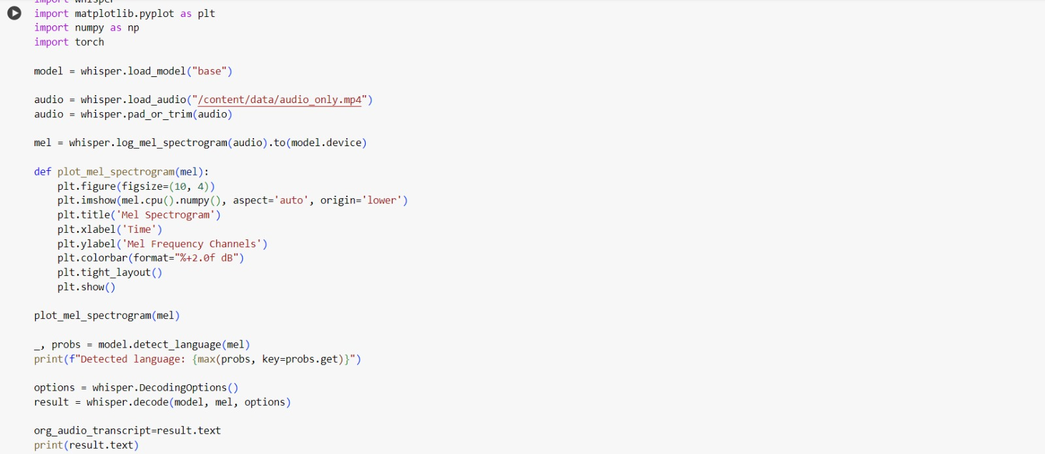

Slide 28
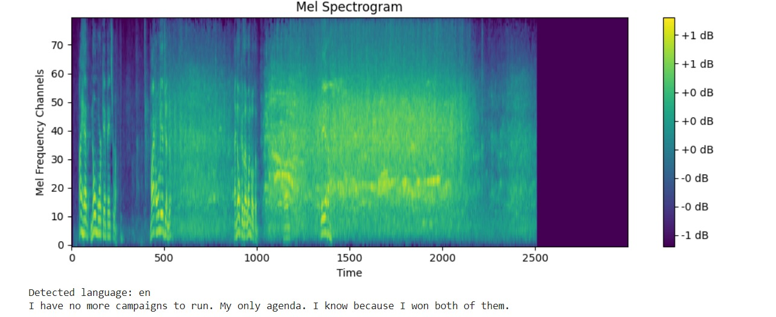

Slide 29
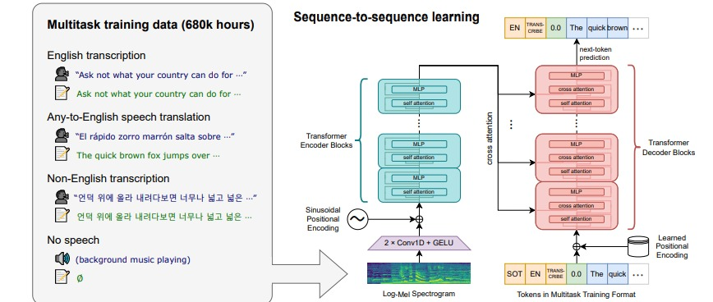

Slide 30
Task To Do In End Term
1. Implementation of Methodology
2. Testing on Dataset
3. Model Validation
4. UI Designing

Slide 31
References
[1] Shi, C., Dou, J., Liu, W., & Xing, J. (2023). Lost in Translation: Lip-Sync Deepfake Detection from Audio-Video Mismatch. IEEE/CVF Conference on Computer Vision and Pattern Recognition (CVPR) Workshop.
[2] Datta, S. K., Jia, S., & Lyu, S. (2024). Exposing lip-syncing deepfakes from mouth inconsistencies. arXiv
[3] Zhang, L., & Li, Y. (2024). Deepfake detection using deep learning methods: A systematic and comprehensive review. WIRES Data Mining and Knowledge Discovery, Wiley Periodicals LLC.
[4] Al-Khalifa, S., & Ahmed, M. (2023). DeepFake Videos Detection by Using Recurrent Neural Network (RNN). Al-Sadiq International Conference on Communication and Information Technology (AICCIT-2023), IEEE.

Slide 32
Thank You

